Slide 1
Tax Sevak: An Android application for GST manipulation and Returns

Slide 2
INTRODUCTION
What is GSTIN?
To operate under GST, manufacturers,service providers and traders will need a GST Identification Number (GSTIN) - which will be a 15 digit PAN based number.
A not for profit organization called Goods and Service Tax Network (GSTN) has been assigned the responsibility to set up the Information Technology of the Goods and Service Tax (GST).
GSTN is working in collaboration with the State Governments to collect information on existing taxpayers and issue them Tax Identification Number (TIN).

Slide 3
CONTENTS
Objectives
Introduction
System Architecture
Results and Analysis
Applications
Conclusion

Slide 4
Objectives:
Design and development of Android application for GST returns.
Calculating tax returns for goods.
E-way bill calculation and payment.
Finding the transportation for goods services.
Information about goods rates and tax.

Slide 5
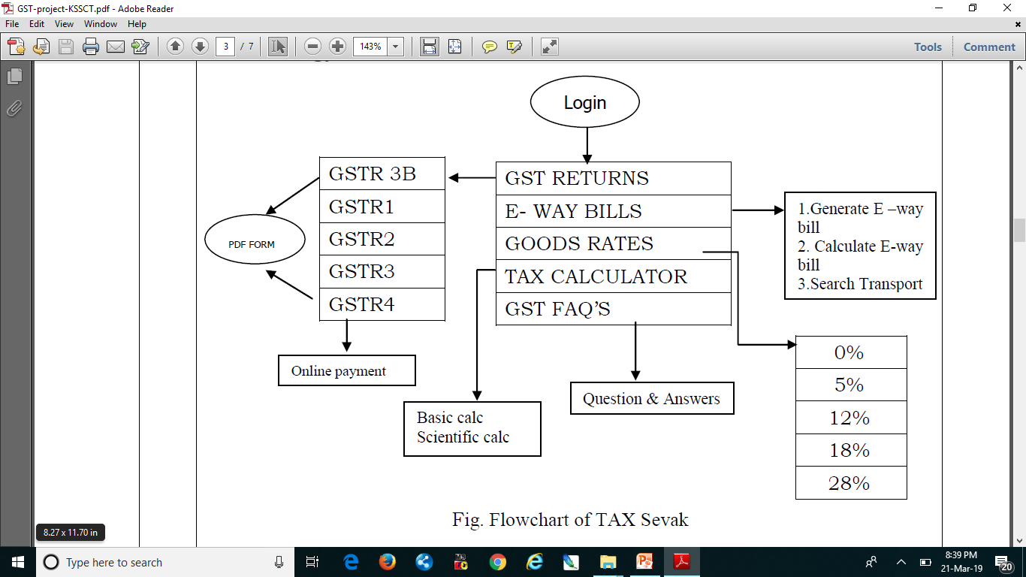
System Architecture

Slide 6
Specification
1 Software Requirements :
• OS: Windows XP, 7 or above.
• Editor: Android studio.
• Toolkit: ADT: Android Developer Tools , JDK.
2 Hardware Requirements :
• Desktop/laptop.
• Android smart phone.
• RAM: 4GB/Above both for client and server.
• Processor: i3/Above.

Slide 7
Results And Analysis
User End: User can either register through the new user login or login through the current user. User sends the request to the server side for further process which involves Feature Extraction, Feature Matching. Final result is displayed on the user App.
Server End: The request is sent from the client side. The Server Search for the request in the database using the URL which is given in the main server of services.gst of govt Then server send Required response to the client side.

Slide 8
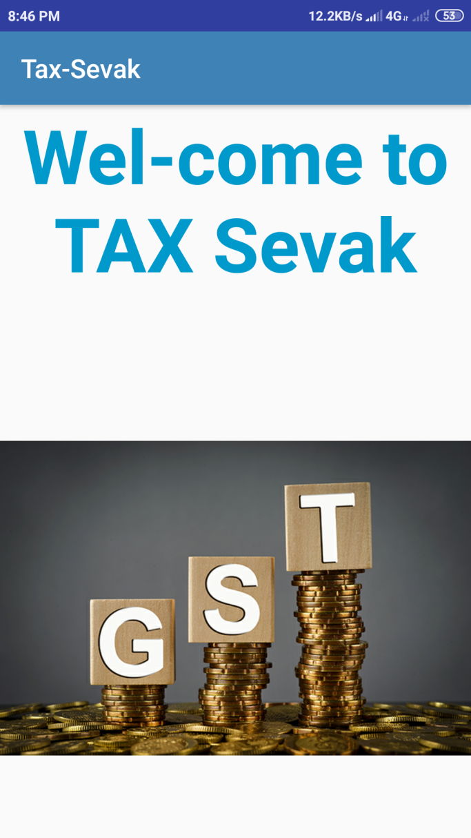
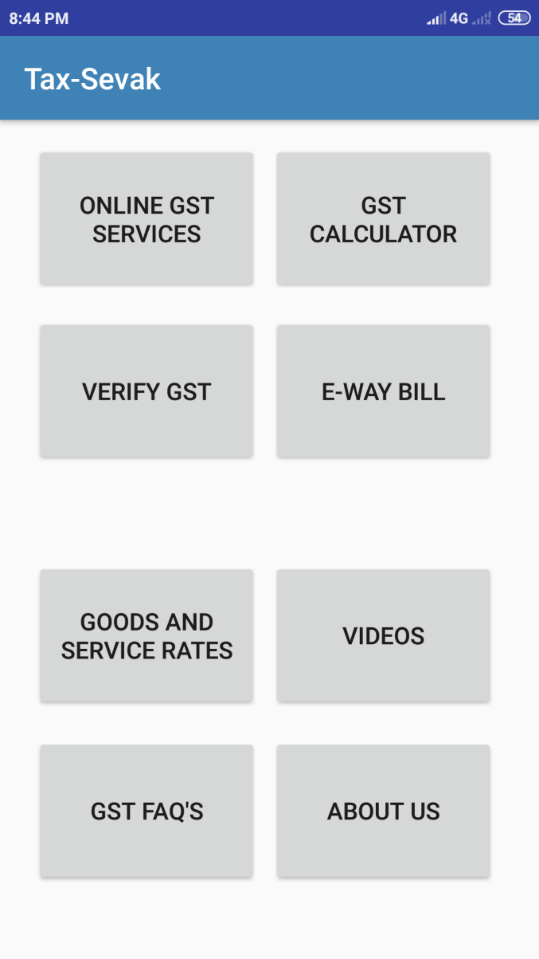
Result and analysis

Slide 9
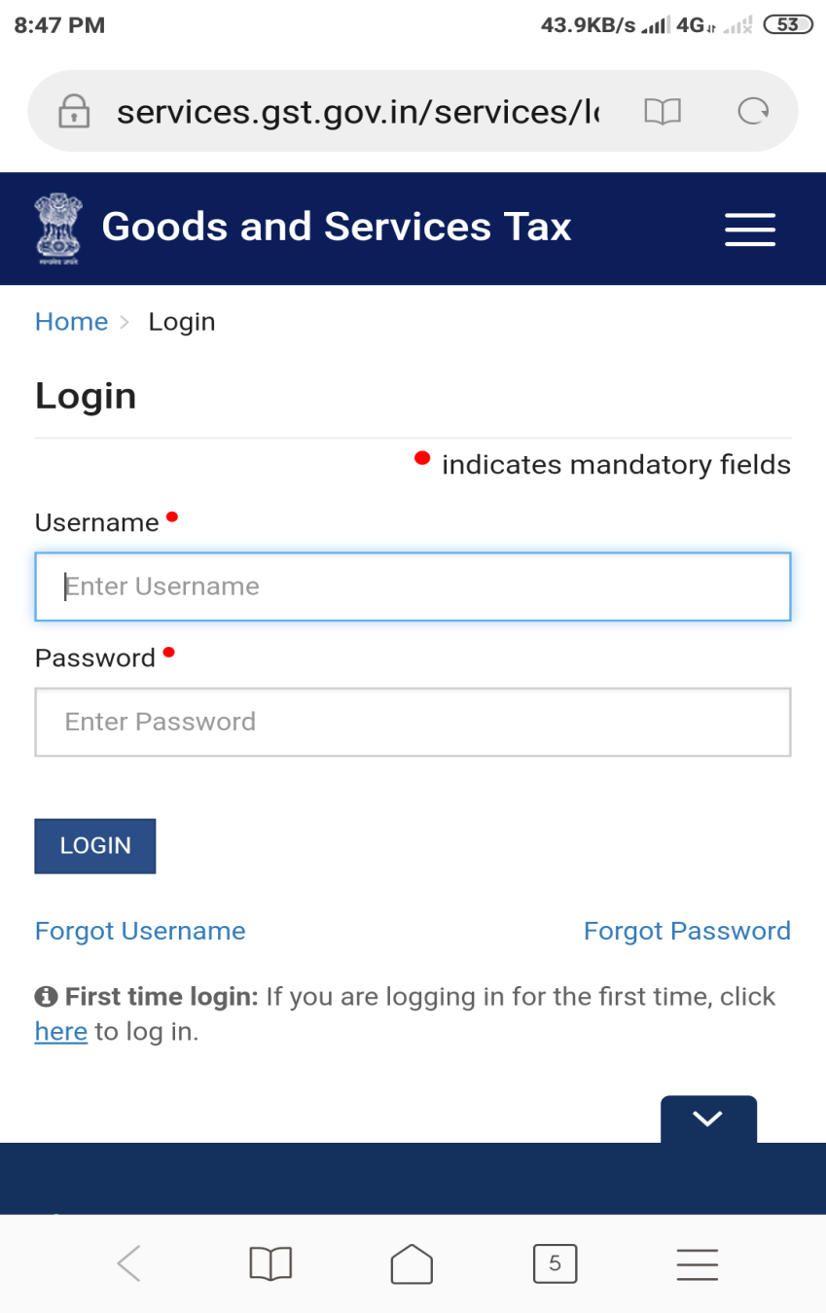
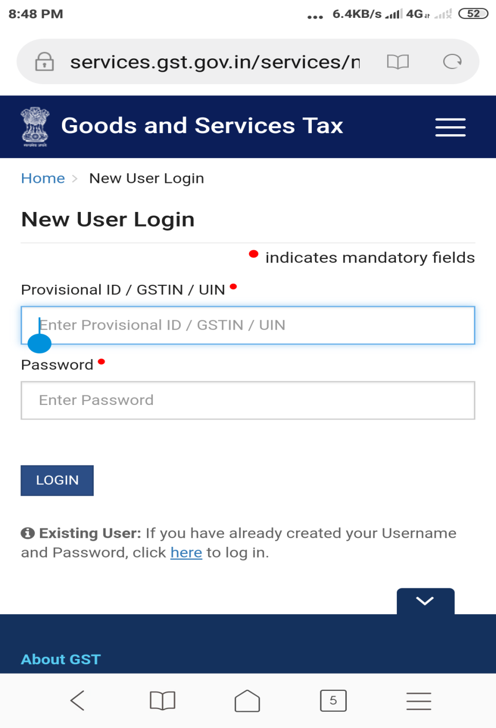
Online GST Services:

Slide 10
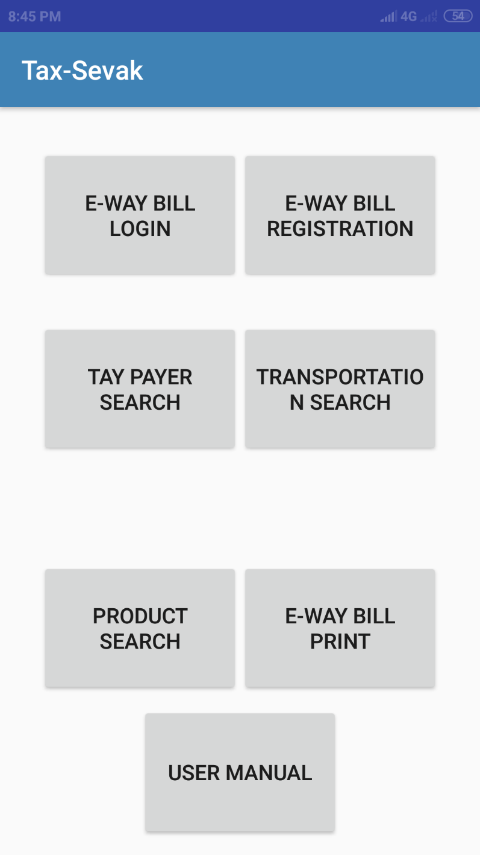
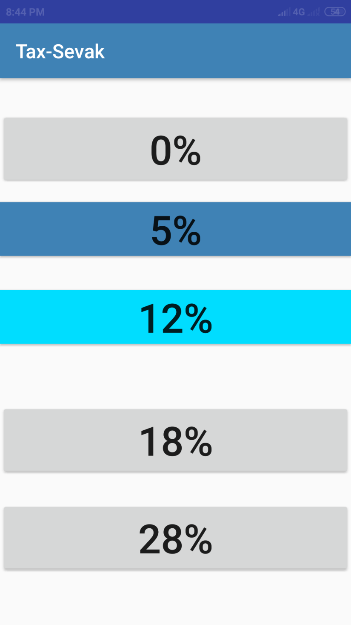

Slide 11
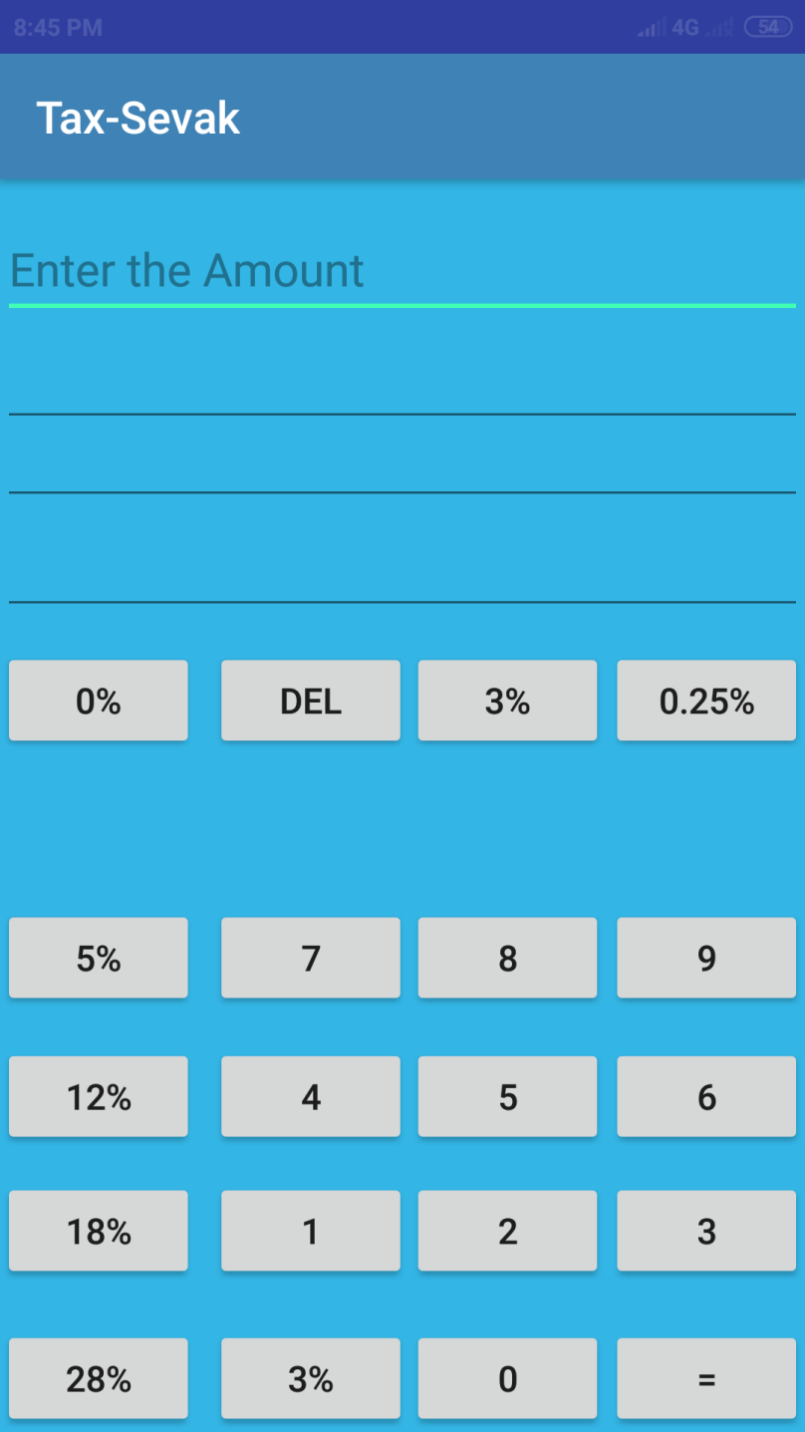
GST calculator

Slide 12
Advantages and Applications
Advantages:
User friendly mobile app for GST returns.
Easy to calculate tax rates.
Simple way to E – way bill generation and return.
Simple returns tax calculator.
Applications:
Helps for Income Tax Department.
Helps in Retail Shops and small shops.
Helps in Industries to calculate GST.

Slide 13


HOW TO PAY THE TAX WITH THIS BUSY SCHEDULE
Ohhh……….!!!!!!!!! Its already 30 JAN.

Slide 14
…..???
ONLINE PAYMENT..?
TO PAY HARD CASH…?

Slide 15
ONE OF HIS FRIEND SUGGESTING ABOUT TAX SEVAK MOBILE APPLICATION.

Slide 16

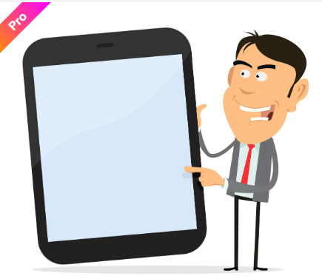
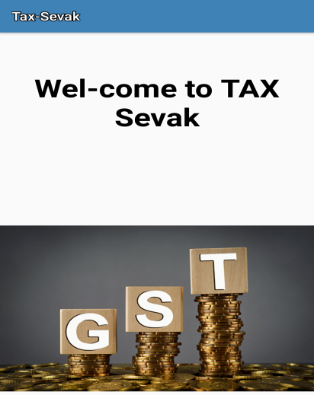
BROWSING ABOUT
TAX SEVAK APLLICATION.
FINALLY DONE .

Slide 17

AN OVERVIEW OF THE COMPLETE PROJECT HOW IT WORKS.
FINAL WORKING OF THE ANDROID APPLICATION OF TAX SEVAK.

Slide 18
THANK YOU

